Slide 1
Natural Language Processing(NLP)

Slide 2
What is NLP?
  Natural language processing (NLP) is a subfield of computer science and artificial intelligence (AI) that uses machine learning to enable computers to understand and communicate with human language.
  Natural Language Processing (NLP) has seen tremendous growth and development, becoming an integral part of various applications, from chatbots to sentiment analysis.
  NLP is already part of everyday life for many, powering search engines, prompting chatbots for customer service with spoken commands, voice-operated GPS systems and question-answering digital assistants on smartphones such as Amazon’s Alexa, Apple’s Siri and Microsoft’s Cortana.

Slide 3
Why Learn NLP?
  More than 80% of the data in this world is unstructured in nature, which includes text. You need text mining and Natural Language Processing (NLP) to make sense out of this data.
  Natural Language Processing (NLP) helps you extract insights from emails of customers, their tweets, and text messages.
  Natural Language Processing (NLP) can power many applications, such as language translation, question-answering systems, chatbots, and document summarizers.

Slide 4
Natural Language Processing(NLP) In Data Science.
  Applications of NLP in Data Science:
  Sentiment Analysis: Sentiment analysis is a popular NLP application that involves determining the emotional tone of a piece of text, such as social media posts, reviews, or customer feedback.
  Language Translation: NLP has revolutionized language translation with machine translation systems. These systems use sophisticated algorithms to automatically translate text from one language to another, facilitating communication across linguistic barriers and empowering global collaboration.

Slide 5
Natural Language Processing In Data Science.
  Chatbots and Virtual Assistants: NLP plays a central role in chatbots and virtual assistants, enabling them to understand user queries and respond intelligently. Advanced NLP models power conversational agents to provide personalized and contextually relevant responses, enhancing user experience in various applications like customer support, e-commerce, and healthcare.
  Text Summarization: NLP algorithms can summarize long documents, articles, or news stories, extracting the most critical information and presenting it in a concise format. Text summarization helps users quickly grasp the main points of large volumes of text, saving time and improving efficiency.

Slide 6
Text Preprocessing in NLP
  One of the foundational steps in NLP is text preprocessing, which involves cleaning and preparing raw text data for further analysis or model training.
  Proper text preprocessing can significantly impact the performance and accuracy of NLP models.

Slide 7
Why Text Preprocessing is Important?
    Raw text data is often noisy and unstructured, containing various inconsistencies such as typos, slang, abbreviations, and irrelevant information. Preprocessing helps in:
    Improving Data Quality: Removing noise and irrelevant information ensures that the data fed into the model is clean and consistent.
    Enhancing Model Performance: Well-preprocessed text can lead to better feature extraction, improving the performance of NLP models.
    Reducing Complexity: Simplifying the text data can reduce the computational complexity and make the models more efficient.

Slide 8
Text Preprocessing Technique in NLP.
  Text Cleaning
  Tokenization
  Stop Words Removal
  Stemming and Lemmatization
  Handling Contractions
  Handling Emojis and Emoticons
  Spell Checking

Slide 9
Text Preprocessing Technique in NLP.
  Now, we will perform the tasks on the sample corpus:
  corpus = [
  "I can't wait for the new season of my favorite show!",
  "The COVID-19 pandemic has affected millions of people worldwide.",
  "U.S. stocks fell on Friday after news of rising inflation.",
  "<html><body>Welcome to the website!</body></html>",
  "Python is a great programming language!!! ??"
  ]

Slide 10
Text Preprocessing Technique in NLP.
  Now, we will perform the tasks on the sample corpus:
  corpus = [
  "I can't wait for the new season of my favorite show!",
  "The COVID-19 pandemic has affected millions of people worldwide.",
  "U.S. stocks fell on Friday after news of rising inflation.",
  "<html><body>Welcome to the website!</body></html>",
  "Python is a great programming language!!! ??"
  ]

Slide 11
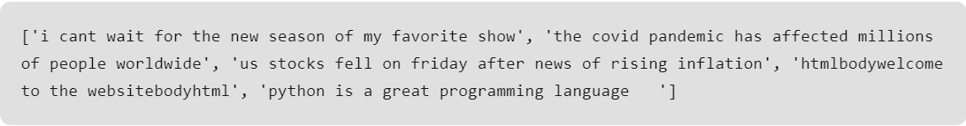
Text Cleaning
  We’ll convert the text to lowercase, remove punctuation, numbers, special characters, and HTML tags.
  Output:

Slide 12
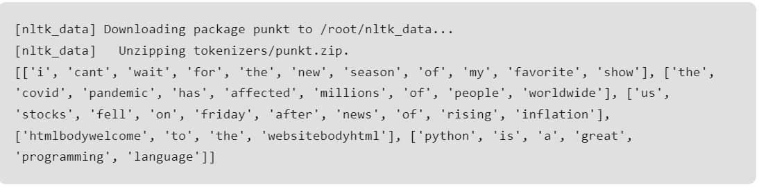
Tokenization
  Splitting the cleaned text into tokens (words).
  Output:

Slide 13
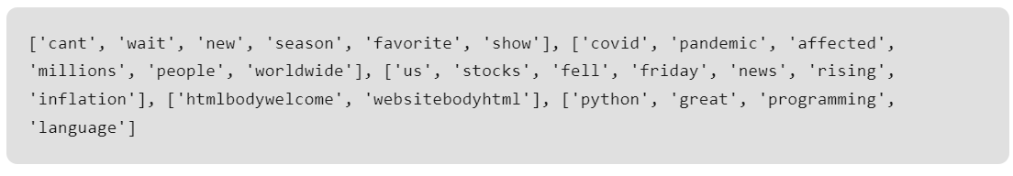
Stop Words Removal
  Removing common stop words from the tokens.
  Output:

Slide 14
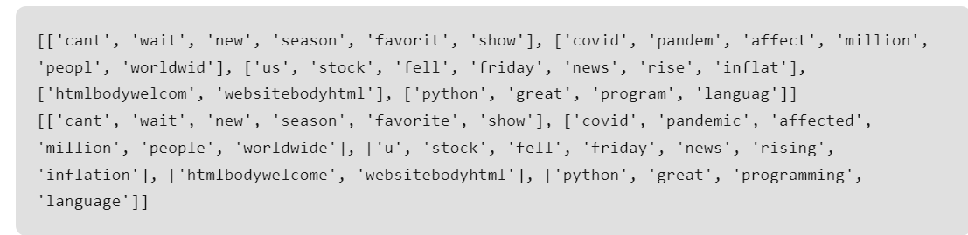
Stemming and Lemmatization
  Reducing words to their base form using stemming and lemmatization.
  Output:

Slide 15
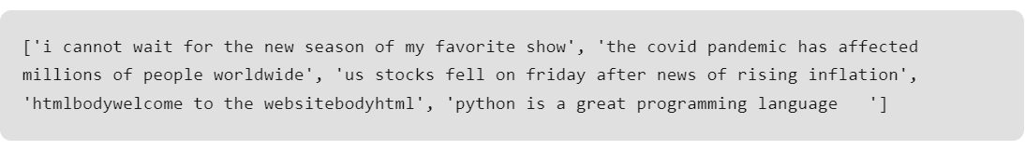
Handling Contractions
  Expanding contractions in the text.
  Output:

Slide 16
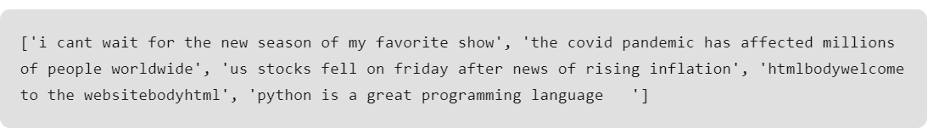
Handling Emojis and Emoticons
  Converting emojis to their textual representation.
  Output:

Slide 17
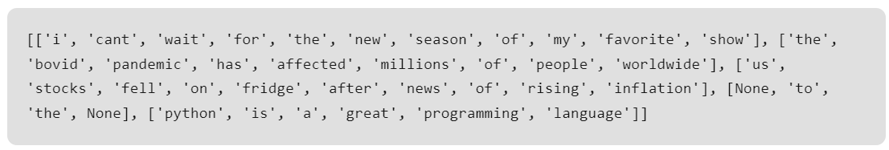
Spell Checking
  Correcting spelling errors in the text.
  Output:

